Slide 1
Welcome to
DEPARTMENT OF MATHEMATICS
GOVERNMENT CHANDULAL CHANDRAKAR ARTS AND SCIENCE COLLEGE, PATAN, DIST-DURG

Slide 2
ESTABLISHMENT OF THE COLLEGE -
16 AUG 1989
B.Sc. (MATHEMATICS) –1990-91
M.Sc. (MATHEMATICS) - 2017-18
Ph.D. Registration and
Scholar Registered with guide –March-2021

Slide 3
Content of the PPT
SLIDE NO. | NAME OF THE SLIDE
4 | VISION
5 | MISSION
6 | GOAL
7 | OBJECTIVE
8 | COURSES RUN BY DEPARTMENT
9 | Courses run by the Department-B.Sc.
10 | Courses run by the Department-B.Sc. AND M.Sc.
11 | Program Outcome and Program Specific Outcome
12 | Course Outcome
13 | Sanctioned and Filled post
14 | Achievement

Slide 4
Content of the PPT
14 | ACHIEVEMENT
15-17 | ACHIEVEMENT, ACADEMIC ACHIEVEMENT & LIST OF PUBLISHED PAPERS
18 | PUBLICATION ACHIEVEMENT
19 | OTHER RESEARCH ACTIVITY
20 | MOU WITH TWO COLLEGES
21-22 | ENROLLED AND EXAM RESULTS OF B.SC.-III
23-24 | EXAM RESULT (M.SC. MATHEMATICS)
25 | PROGRAM ORGANIZED
26 | PROGRAM PHOTO
31 | ONLINE COACHING TO PHD RESEARCH SCHOLAR
32-40 | MEMORABLE ACHIEVENTS
41 | FUTURE PLAN VISION 2030
42 | OUR RESEARCH SCHOLAR
43-47 | ALUMNI

Slide 5
DEPARTMENT OF MATHEMATICS
VISION
To keep the flame of mathematics burning even in the rural area and resourceless environment by maintaining the low cost quality education matching to college’s vision and through the dedication in mathematics. To emerge as a National Center of learning, academic excellence, and innovative research in this rural area.

Slide 6
Mission
To produce post graduate students with strong foundation to join research or to serve in the Society.
To make students competent in the life that they can never be defeated in the transforming scenario.
To achieve the high standards of excellence in generating and propagating mathematical knowledge.
To provide an environment where students can learn, become competent users of mathematics, and understand the use of mathematics in other disciplines.
To create an atmosphere conductive to high class research and to produce researchers with clear thinking and determination, who can become experts in future in relevant areas of Mathematics.

Slide 7
GOAL
Guiding the students for an overall development to meet the ever growing challenges of the society with Mathematical tools.
To give the individual an understanding of ideas and operations in number and quantity needed in daily life.
To enable the individual to apply his mathematics to a wide range of problems that occur in daily life.
To enable the student to acquire and develop mathematical skills and attitude to meet the demands of (i) daily life (ii) future mathematical work and (iii) work in the related fields of knowledge.

Slide 8
OBJECTIVE
Acquire knowledge and understanding of the terms, concepts, principles, processes, symbols and mastery of computational and other fundamental processes that are required in daily like and for higher learning in mathematics.
Apply mathematical knowledge and skills to solve problems that occur in daily life as well as problems related to higher learning in mathematics or allied areas.
To develops ability to analyze, to draw inferences, and to generalize from the collected data and evidence.
Apply mathematical knowledge and skills to solve real mathematical problems by developing abilities to analyze, to see interrelationship involved, to think and reason.
Develop necessary skills to work with modern technological devices such as calculations, computers, etc.

Slide 9
Courses run by the Department-B.Sc.
B.Sc. In Mathematics- Along with two other subject (Physics & Chemistry), or, B.Sc. (PCM)
This is a three year Undergraduate degree course, also called B.Sc. (PCM)
This course was started from 1990.
Affiliated to Hemchand Yadav University, Durg
Examination Pattern- Annual Examination (with 10% internal marks given by internal assessment by organizing Internal Model Exam)
Sanctioned seat of 60 student

Slide 10
Courses run by the Department-M.Sc.
M.Sc. in Mathematics from 2017-18.
This is a two year course, consists of 4 semester of six-month each.
This course was started by an order of Chhattisgarh Government of Higher Education, Raipur in 2017-18
There is Temporary affiliation of the M.Sc. Mathematics course.
It is Affiliated with HEMCHAND YADAV University, Durg
It has an intake of 25 student.
01 Post of Professor is vacant, and the Contract Teacher is filled against it.
Only two batches of Examinee has passed-out from the PG Department Course
2017-2019 Batch: 05 enrolled 05 Examinee 03 Passed
2018-2020 Batch: 25 enrolled 19 Examinee 18 Passed

Slide 11
Program Outcome and Program Specific Outcome
Program Outcome | Program Specific Outcome
Skill to Analyze Problems. | Method of solving in Mathematics
Effective Scientific and/or Technical Communication. | Develop the calculating abilities.
Inculcate Critical Thinking. | Acquire an understanding of basic object oriented concepts and the issues involved in Mathematical Problems
Continue to Acquire relevant Knowledge and Skills. | Develop the ability of Observation of problems, Illustration of examples, Proving technique, and analyze the concept.
Create awareness to become an enlightened citizen. | Power to Formulate the Mathematical problems.

Slide 12
Course Outcome

Slide 13
SANCTIONED AND FILLED POSTS
SANCTIONED POST-
(a) Professor-01
(b) Assistant Professor- 01
( c) Local Management Committee (JBS)-01
FILLED POST-
(a) Contract Teacher SRI JAINENDRA SHRIVAS (2018-Till today)
(b) Dr. ROHIT KUMAR VERMA (1994-Till Today)-Asstt. Prof.
( c) Sri PRASHANT VISHWAKARMA (2017-2020)-JBS and then
DEVI VAISHNAV (2020-2021)-JBS

Slide 14
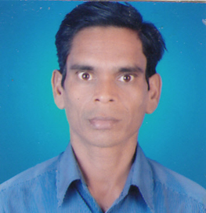
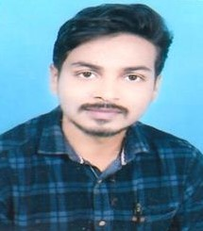
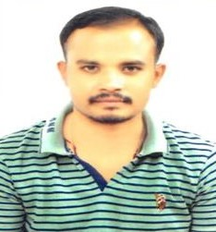
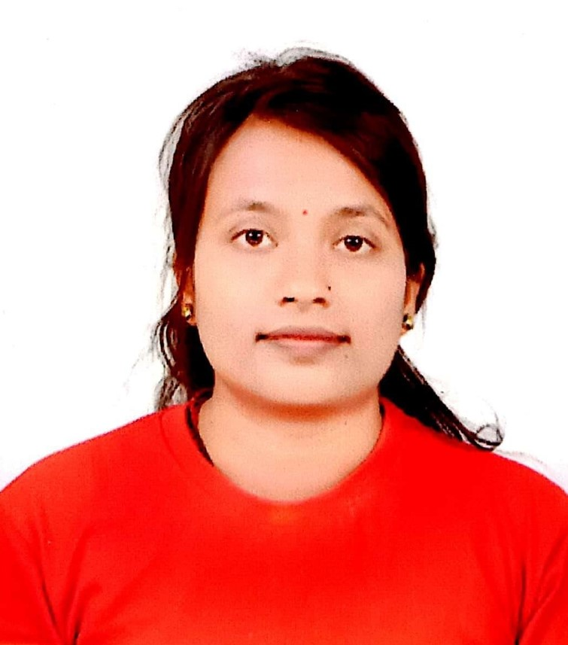
SANCTIONED POST-1 Professor (Contract Teacher is working against it, 01-Assistant Professor-Dr. R. K. VERMA IS WORKING AGAINST IT. 01-POST IS SANCTIONED BY JBS-COMMITTEE) TEACHING STAFF
 | DR. ROHIT KUMAR VERMA, (HOD), Assistant Professor (Mathematics) 1994 onwards Experience-28 Years |  | DR. ROHIT KUMAR VERMA, (HOD), Assistant Professor (Mathematics) 1994 onwards Experience-29 years
 | SRI JAYNENDRA SHRIVAS (Contract Teacher) Govt. C.L.C. College patan 2018-19 Onwards Experience-3 years |  | SRI JAYNENDRA SHRIVAS (Contract Teacher) Govt. C.L.C. College patan 2018-19 Onwards Experience-3 years
 | SRI PRASHANT VISHWAKARMA (JBS Teacher) Govt. C.L.C. College Patan 2017-18 to 2019-20 Experience-3 Years |  | MS. DEVI VAISHNAV (JBS Teacher) Govt. C.L.C. College Patan 2020-21 onwards Experience-1 Years

Slide 15
Achievements
Post graduate course in Mathematics from 2017-18.
More than 20 Research Papers. In reputed Journals
9 text-books published. Two of them in single authorship by Dr. R. K. Verma
Research Guide from 2020-21 and 02 Research candidate registered.
1 candidate NET passed.
At least 20 Gazette officers or equivalent posts, e.g., CEO, Ayukt, ASP, NT etc.
Many teachers serving in Rural, Tribal areas and Private sectors.
Many students in Police, Railway, Coaching, ICDS, Post-office, Panchayat, Social Servicing, Teaching in Schools and colleges, and also Laboratory.
First prize in State Level Mathematics Competition exams held at VYT Durg.
Organized Madhav Mathematics Competition Exam, 36 competitors.

Slide 16
Academic Achievements
List of Reserch Papers Published in International Journals by Dr. R. K. Verma
1. R.K. Verma, H.K. Pathak; Common Fixed Point Theorems in Complex Valued Metric Space and Application, Thai Journal of Mathematics Volume 17 (2019) Number 1 : 75–88, http://thaijmath.in.cmu.ac.th e-ISSN 1686-0209
2. Rohit Kumar Verma, FIXED POINT THEOREMS USING (CLCS) PROPERTY IN COMPLEX VALUED $b$-METRIC SPACES, Facta. Universitatis Ser. (Math & Computer) 32(3)(2017), pp.269-292, http://casopisi.junis.ni.ac.rs/index.php/FUMathInf/article/view/945 DOI Number-10.22190/FUMI1703269V
3. R. K. Verma, COMMON FIXED POINTS IN COMPLEX-VALUED B-METRIC SPACES SATISFYING A SET OF RATIONAL NEQUALITIES, 7(10) (2016), 2016, 143-150 ISSN 2229 – 5046 http://www.ijma.info/index.php/ijma/article/view/4484
4. R.K. Verma, H.K. Pathak; Common Fixed Point Theorems Using Property (E.A) in Complex-Valued Metric Spaces, Thai Journal of Mathematics, vol.-11, No.-2, (2013), 347-355, http://thaijmath.in.cmu.ac.th ISSN 1686-0209
5. R.K. Verma, H.K. Pathak, Solution of nonlinear integral equations via fixed point of generalized contractive condition, Mat. Vesnik 64 (2012), no. 3, 223–231, https://www.emis.de/journals/MV/123/mv12305.pdf
6. R.K. Verma, H.K. Pathak, Common fixed point theorems for occasionally converse commuting mappings in symmetric spaces, Kathmandu Univ. J. Sci., Eng. And Tech. VOL.-7, No. I, 2011, https://www.nepjol.info/index.php/KUSET
7. H.K. Pathak, Rodríguez-López, Rosana, R. K. Verma, A common fixed point theorem of integral type using implicit relation, Nonlinear Funct. Anal. Appl. 15 (2010), no. 1, 1–12,

Slide 17
List of Research Papers Published in International Journals……………CONTINUE
8. H.K. Pathak, R. K., Verma, Common fixed point theorems for weakly compatible mappings on Menger space and application, Int. J. Math. Anal. (Ruse) 3 (2009), no. 21-24, 1199–1206, http://www.m-hikari.com/ijma/
9. H. K. Pathak, R. K., Verma, An integral type implicit relation for converse commuting mappings, Int. J. Math. Anal. (Ruse) 3 (2009), no. 21-24, 1191– 1198 http://www.m-hikari.com/ijma/
10. H. K. Pathak, R. K. Verma, Integral type contractive condition for converse commuting mappings, Int. J. Math. Anal. (Ruse) 3 (2009), no. 21-24, 1183– 1190 http://www.m-hikari.com/ijma/
11. H. K. Pathak, R. K. Verma, B. Fisher, Fixed point and coincidence point theorems on Banach spaces over topological semifields and their applications, Thai J. Math. 7(2009), no. 1, 115–127, http://thaijmath.in.cmu.ac.th
12. H. K. Pathak, R. K. Verma, Coincidence and common fixed points in symmetric spaces under implicit relation and application. Int. Math. Forum 3 (2008), no. 29-32, 1489–1499, 54H25 (47H10) MR2447641, http://www.m-hikari.com/imf-password2008/29-32-2008/index.html
13. H. K. PATHAK, R. K. VERMA, WEAKLY COMPATIBLE MAPPINGS AND ALTMAN TYPE CONTRACTION, Filomat 2:1 (2008), 33–46 https://doi.org/10.2298/FIL0801031P
14. H.K. Pathak, R. Rodriguez-Lopez, R.K. Verma, A common fixed point theorem using implicit relation and property (EA) in metric space, Filomat 21 (2)(2007), 211-234, http://www.doiserbia.nb.rs/Article.aspx?ID=0354-51800702211P#.YHV9RugzY2w
15. H. K. Pathak, R. K., Verma, S.M. Kang, M.S. Khan, Fixed points for weak compatible type and parametrically φ(ε,δ;a)-contraction mappings, Int. J. Pure Appl. Math. 26(2006), no. 2, 247–263, https://ijpam.eu/ ISSN-1311-8080, e-ISSN-1314-3395.

Slide 18
Publication Achievements
LIST OF TEXT BOOKS PUBLISHED BY DR. ROHIT KUMAR VERMA for B.Sc.-1, 2, 3….
1. Algebra & Trigonometry- P. Jha and R. K. Verma, Navbodh Publication (Hindi)
2. Calculus- P. Jha and R. K. Verma, Navbodh Publication (Hindi), RAIPUR
3. Vector Analysis & Geometry- P. Jha, R. K. Verma, Navbodh Publication (Hindi)
4. Advanced Calculus- P. Jha and R. K. Verma, Navbodh Publication (Hindi)
5. Differential Equation- Dr. R. K. Verma, Navbodh Publication (Hindi)
6. Mechanics- P. Jha and Dr. R. K. Verma, Navbodh Publication (Hindi)
7. Analysis- S. Srivastava and Dr. R. K. Verma, Navbodh Publication (Hindi)
8. Abstract Algebra- P. Jha and Dr. R. K. Verma, Navbodh Publication (Hindi)
9. Calculus- Dr. R. K. Verma, Prabodh Publication (Hindi), RAIPUR

Slide 19
OTHER RESEARCH ACTIVITY
Dr. R. K. Verma (Assistant Professor) is Registered as PhD Research Guide in Mathematics from the HEMCHAND YADAV UNIVERSITY, Durg.
Sri Jainendra Srivas (Contract Teacher) is pursuing his PhD degree from Durg University, Durg
Currently two Candidate are registered as PhD scholar under Dr. R. K. Verma, after passing the entrance examination organized by Hemchand Yadav University:
(1)- Pratik Singh Thakur
(2)- Dileshwari Deshmukh

Slide 20
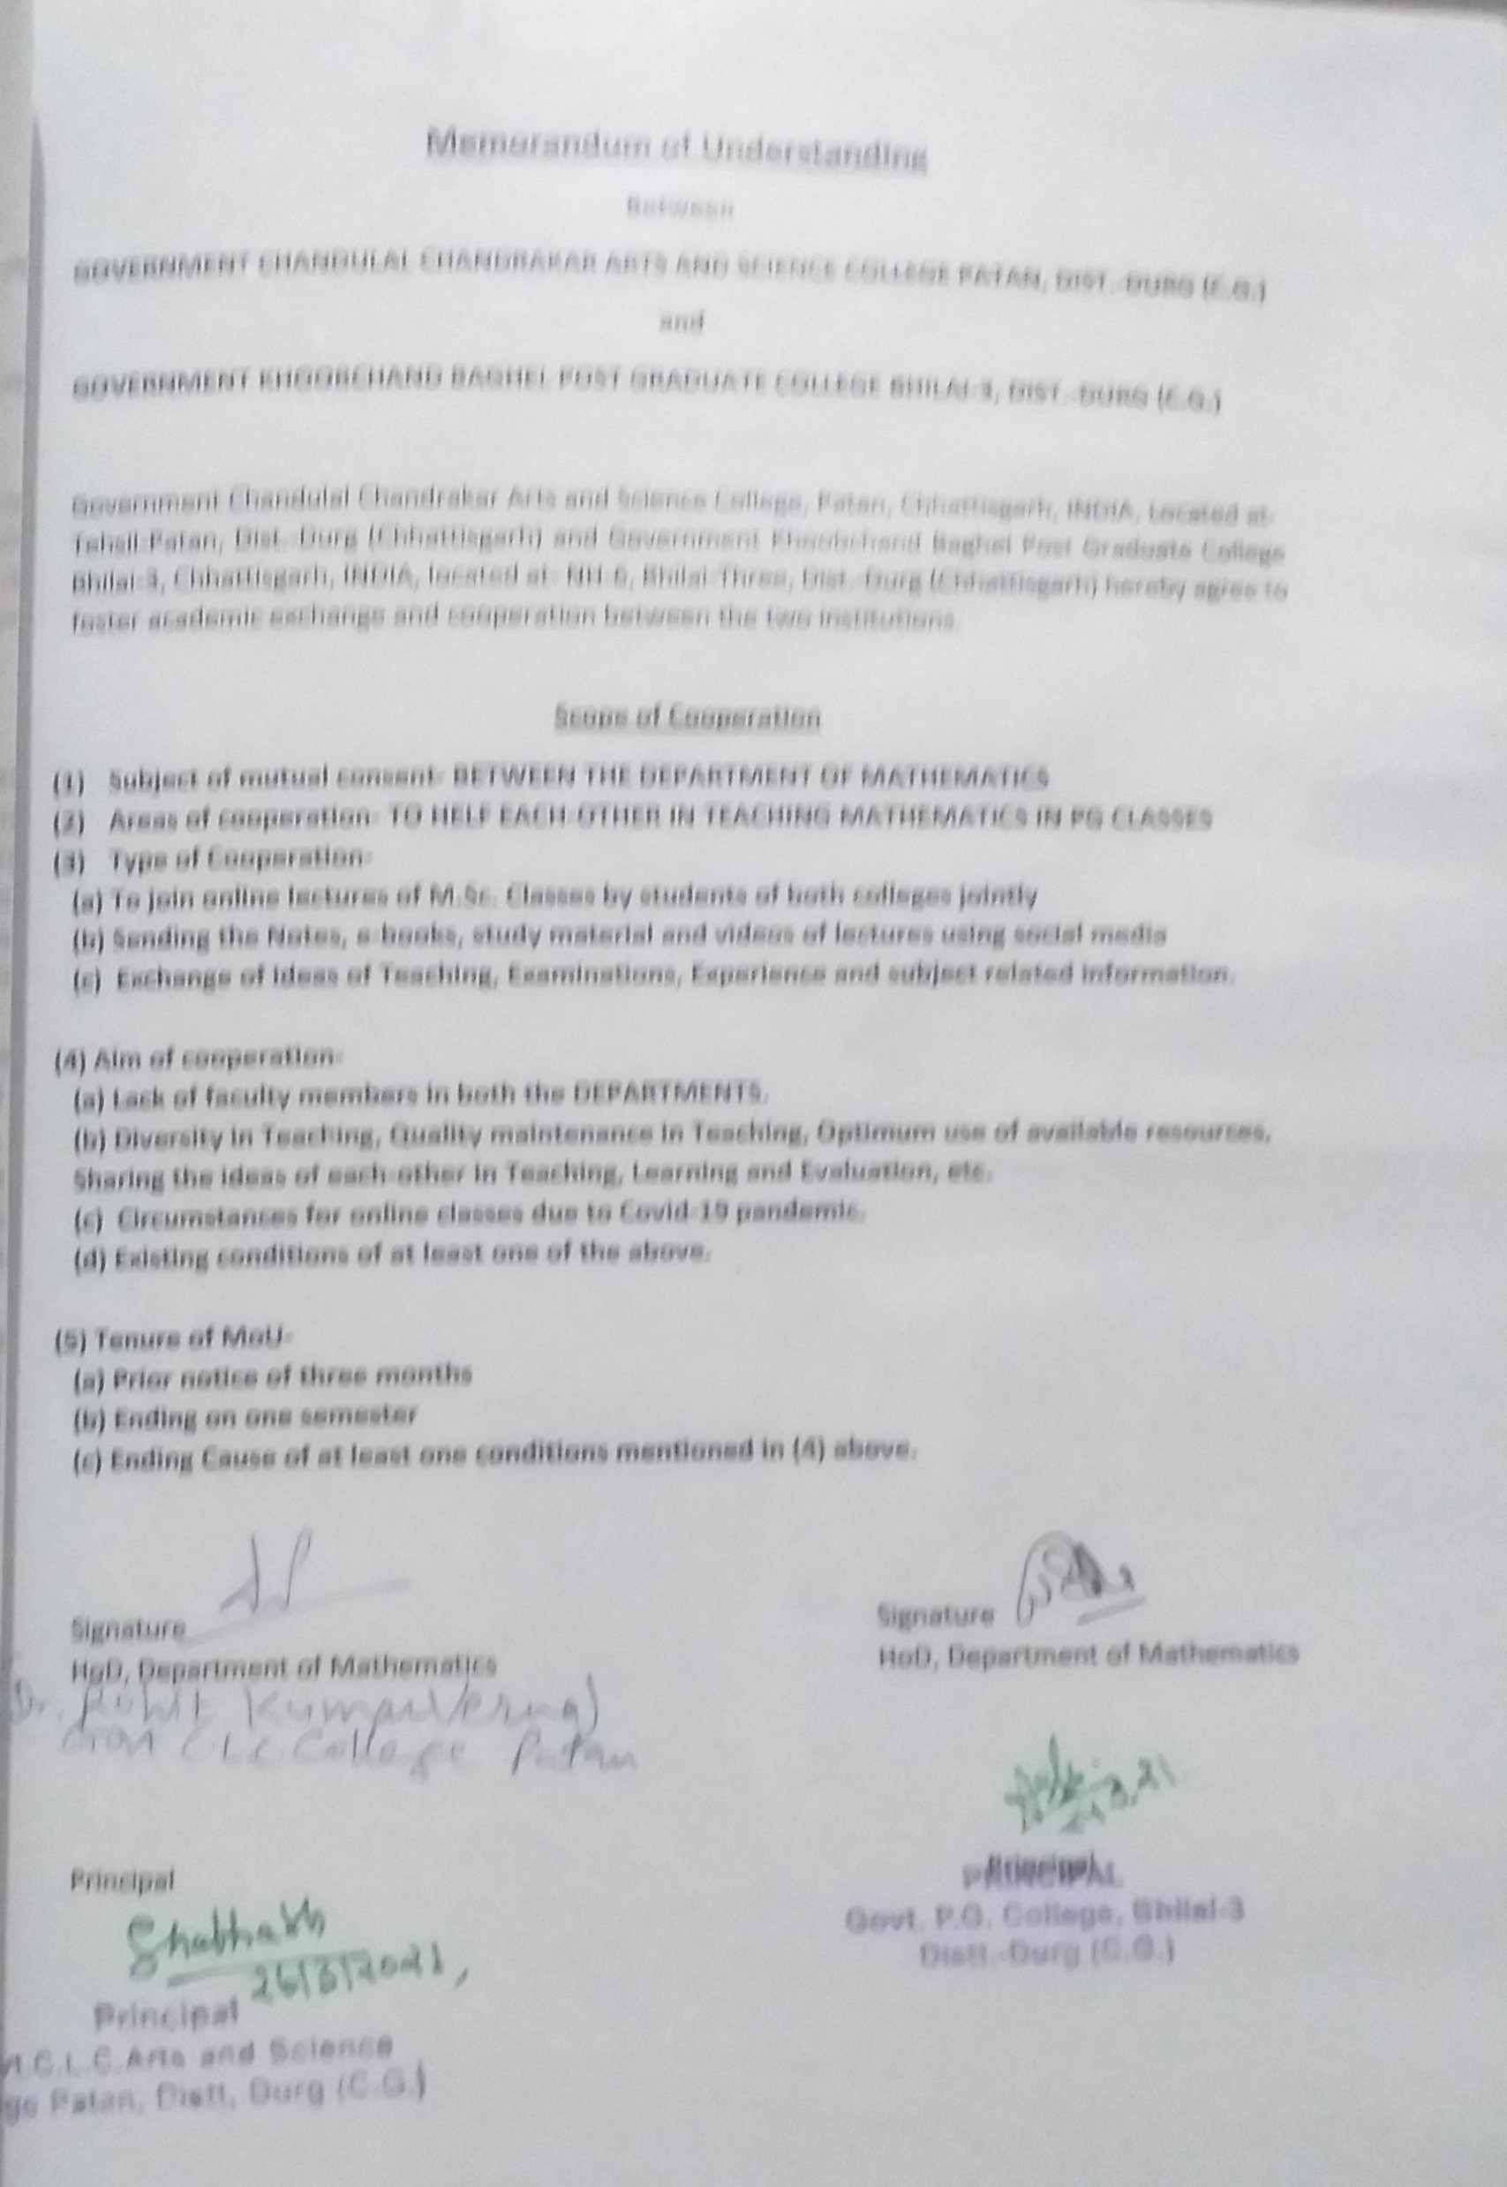
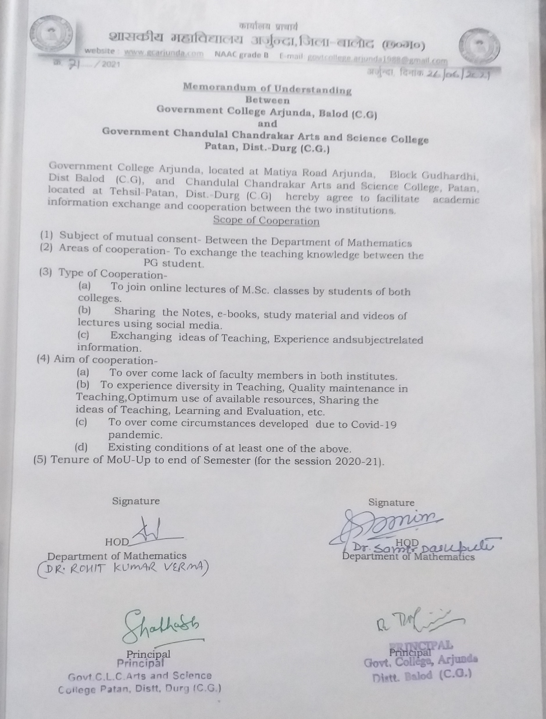
MoU with Government KCB College Bhilai-3, and Govt. College Arjunda, dist.-Balod (C.G.)

Slide 21
ENROLLED AND EXAM RESULTS OF B.SC.-III
YEAR | ENROLLED | APPEARED | PASS | RESULT
2014-15 | 57 | 52 | 46 | 88.46%
2015-16 | 38 | 38 | 36 | 94.73%
2016-17 | 60 | 57 | 45 | 78.94%
2017-18 | 78 | 72 | 51 | 70.83%
2018-19 | 89 | 84 | 62 | 73.81%
2019-20 | 95 | 95 | 93 | 97.87%

Slide 23
EXAM RESULT (M.Sc. MATHEMATICS)
YEAR | ENROLLED IN M.Sc.-IV | APPEARED IN M.Sc.-IV | PASS IN M.Sc.-IV | PASS%
2017-18 | NA | NA | NA | NA
2018-19 | 5 | 5 | 3 | 60.00%
2019-20 | 19 | 19 | 18 | 90.00%

Slide 24
RESULTS OF M.Sc.-IV SEM, AS ON 30.09.2021 (AISHE)

Slide 25
PROGRAM ORGANIZED
PARENT MEET 14.12.2018
MATHS DAY-IMPORTANCE OF ZERO 28.12.2018
MADHAV MATHEMATICS COMPETITION EXAM 12.01.2019
NET EXAM AWARENESS GUEST LECTURE-1 on date Nov.-2019
NET EXAM AWARENESS GUEST LECTURE-2 28.02.2020
SCIENCE QUIZ UNDER THE IQAC 28.02.2016
MUKHYAMANTRI YUVA SWAVLAMBEN YOJNA-MYSY WORKSHOP
CHIPS DATA FITTING OF ALL STUDENTS IN 2015-16 WITH IQAC

Slide 26
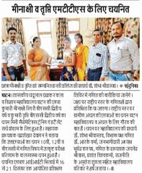
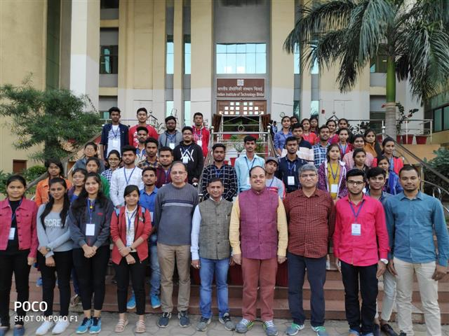
MINAKSHI AND TRIPTI SELECTED AND PARTICIPATED IN MTTS
Minaxi and Tripti selected in the National MTTS-2020 Exam | 6-Day workshop participation by Tripti and Minaxi at IIT Bhilai (C.G.)

Slide 27
Ku. Minakshi Rigree won First prize in state level Mathematics Ability Test on 21-22 Dec. 2018

Slide 28
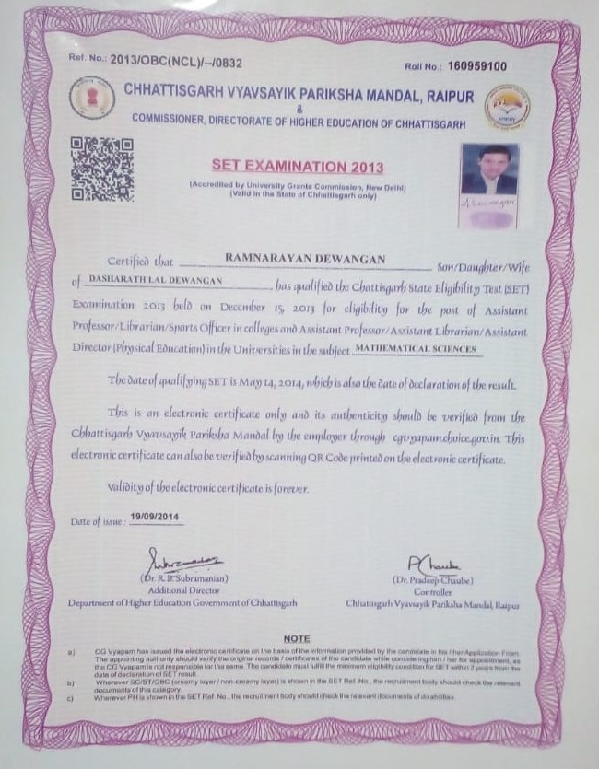
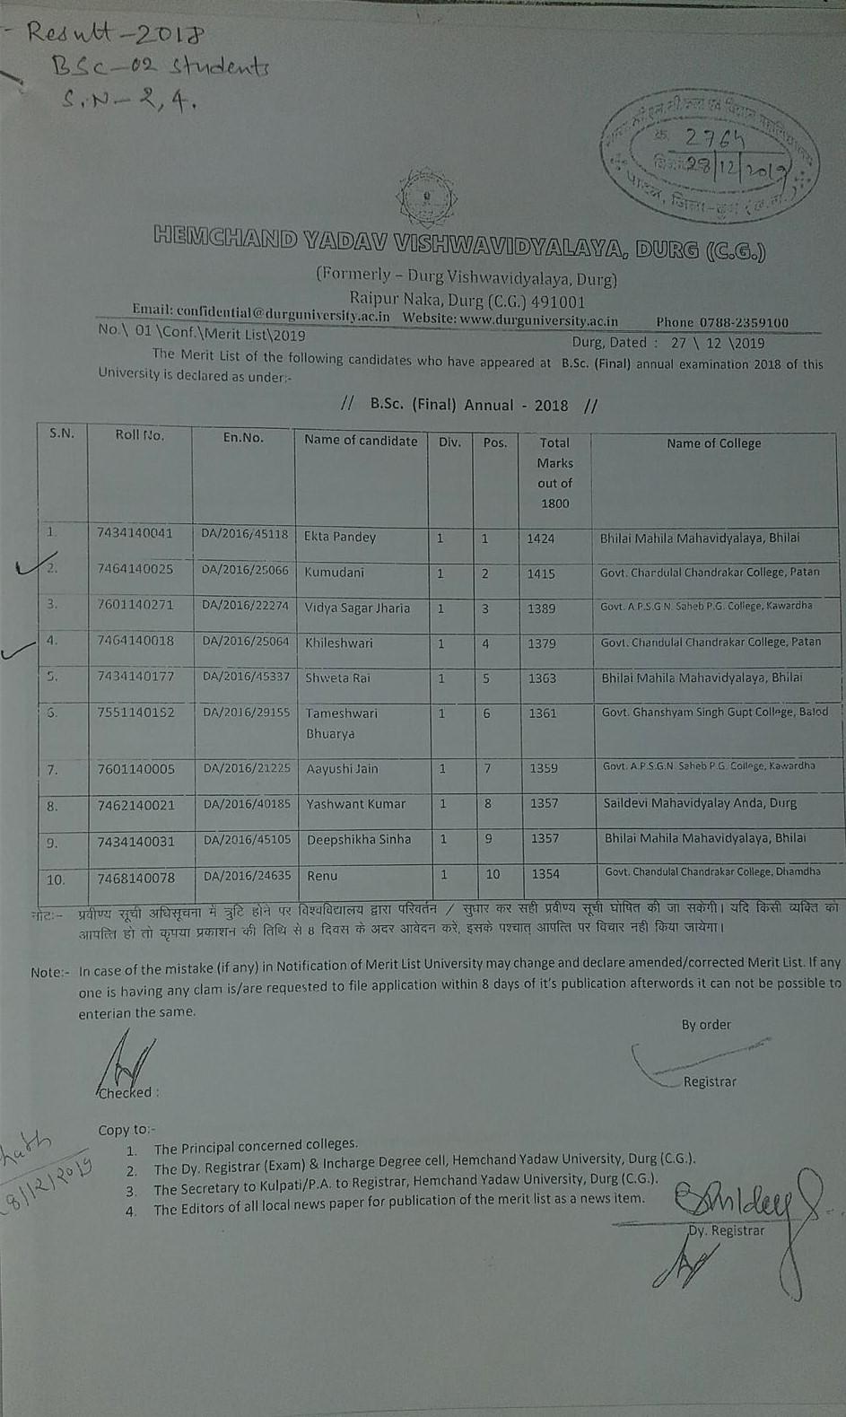
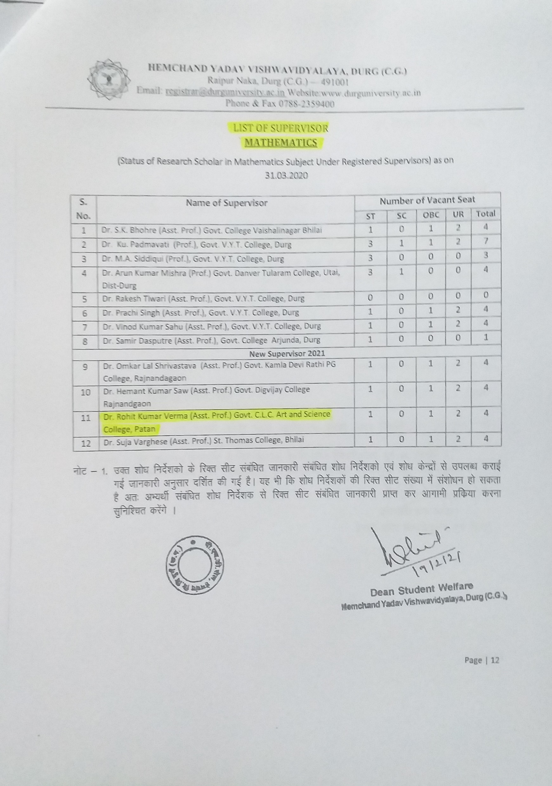
NET PASS, MERIT LIST AND RESEARCH GUIDE CERTIFICATE
Ram Narayan SET Exam- Currently an Asstt. Prof. in Mathematics | Khileshwari Verma 4th and Kumidini Verma 2nd won the Merit Position -2019 | Letter of Research Guide of Dr. R. K. Verma, March-2021

Slide 29
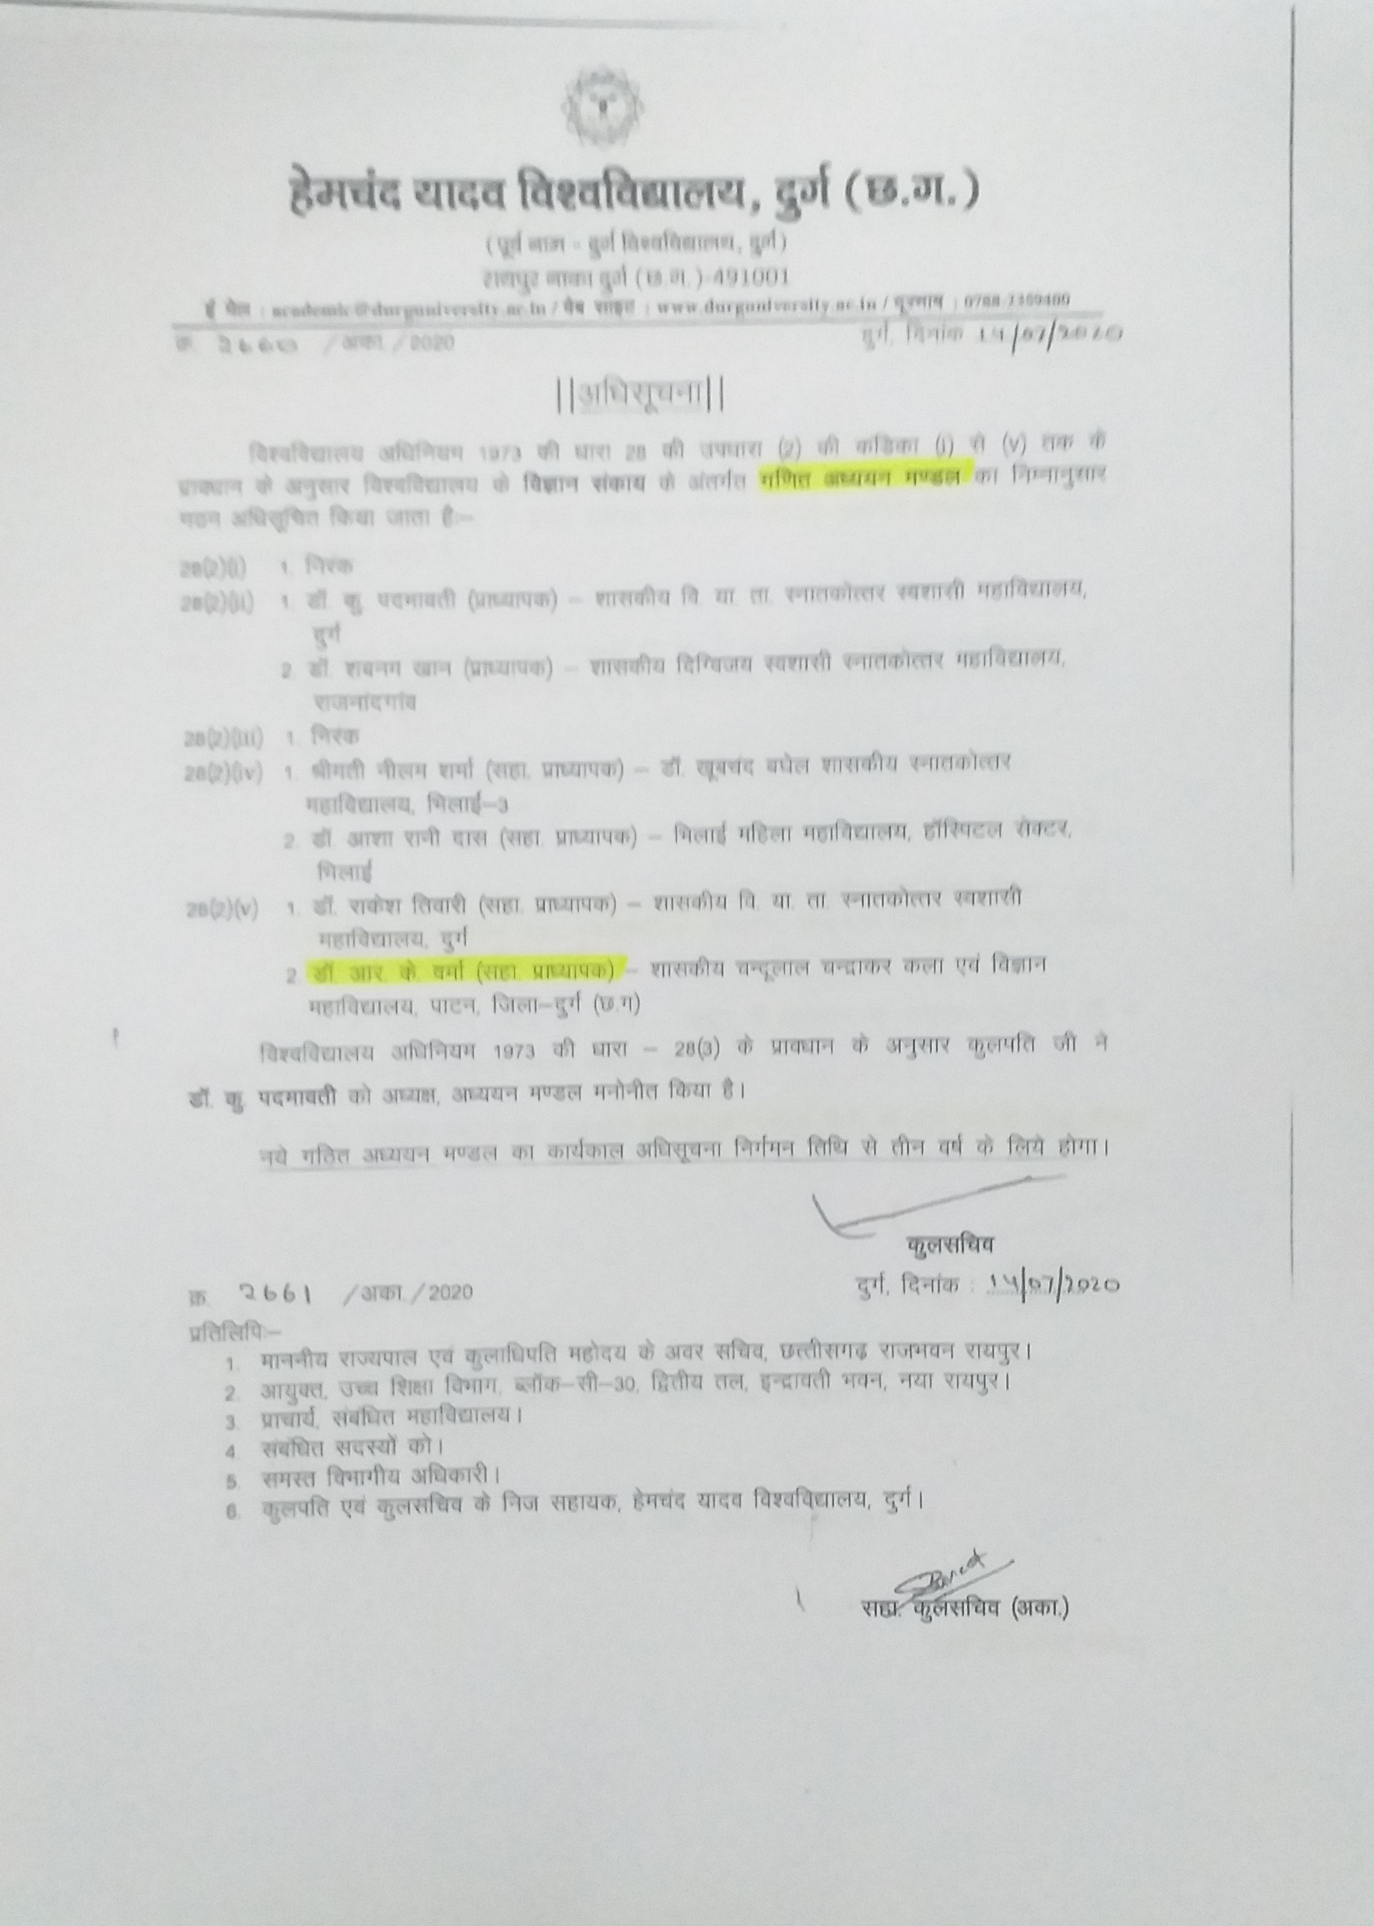
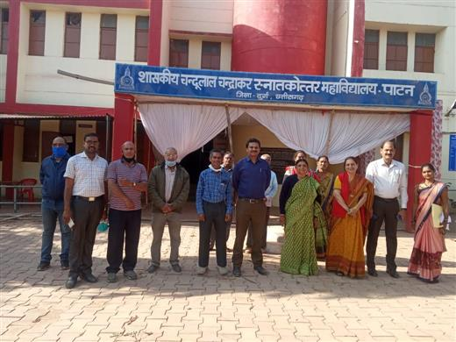
Member of Board of Studies, and Team Affiliation of M.Sc. (Maths)
Member of Board of Studies- Hemchand Yadav University Durg (2020-2023) | Team Affiliation with Principal, HoD (Maths) and other staff members

Slide 30
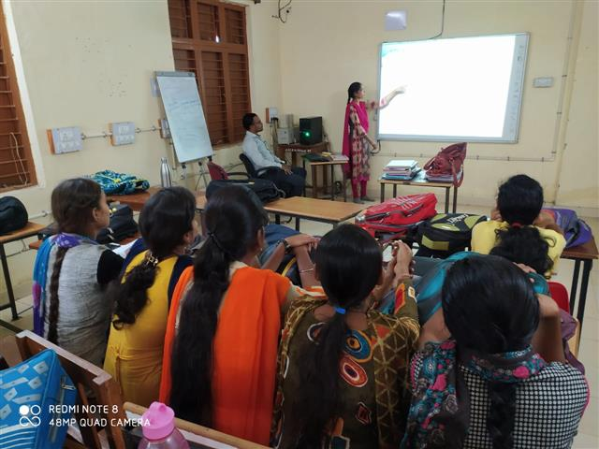
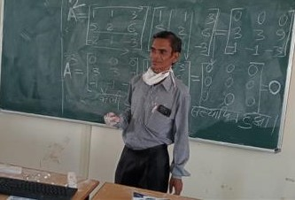
PPT presentation and Centralized Online classroom Teaching -The use of ICT by Department of Mathematics
PPT Presentation by students of Mathematics in the M.Sc.-3rd sem Jan.-2020 | Online Centralized Class by Dr. R. K. Verma in VYT Durg in Nov-Dec. 2020

Slide 31
Online coaching to PhD Research Scholar
http://meet.google.com/uxp-nvif-xqe Date-11.04.2021 time 9.00-9.40 SUNDAY | https://meet.google.com/voh-ogbc-xpoDate 18.04.2021 Time 9.00-9.40 SUNDAY
Date

Slide 32
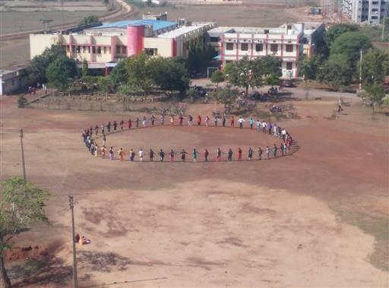
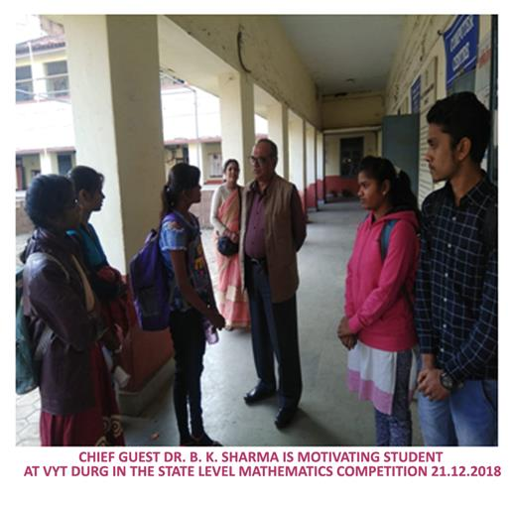
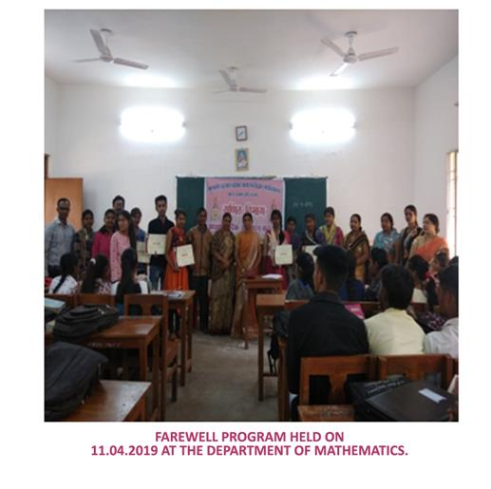
Memorable Achievements - Enhancing Mathematical Environment
To Aware the importance of “ZERO”-a human chain is made in Mathematics Day on December-2019

Slide 33
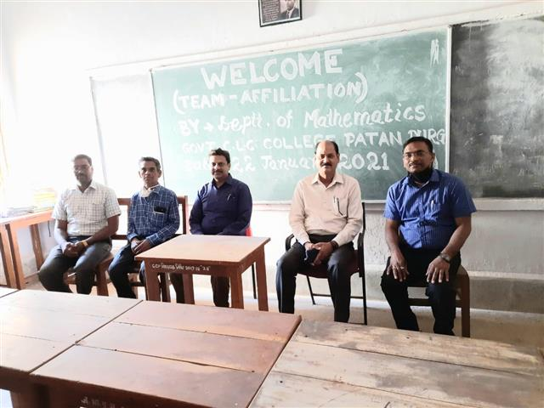
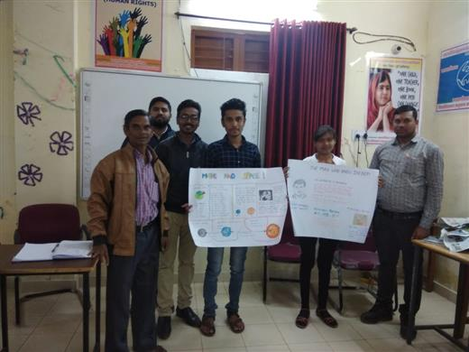
Memorable Achievements in Department of Mathematics
Team Affiliation of Durg University visited in January-2021 | Pankaj Dewangan won stale level Poster competition in Maths Day at VYT-Durg

Slide 34
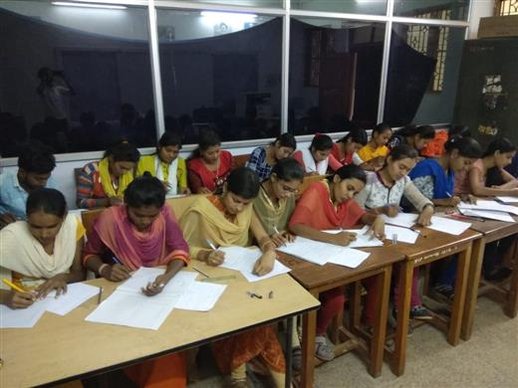
Memorable Achievements in Department of Mathematics
 | Internal Examination of M.Sc.-I sem in Nov.--2019

Slide 35
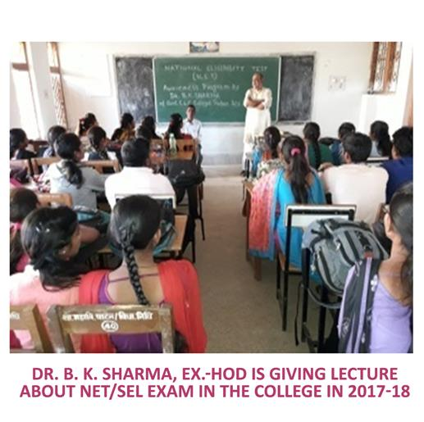
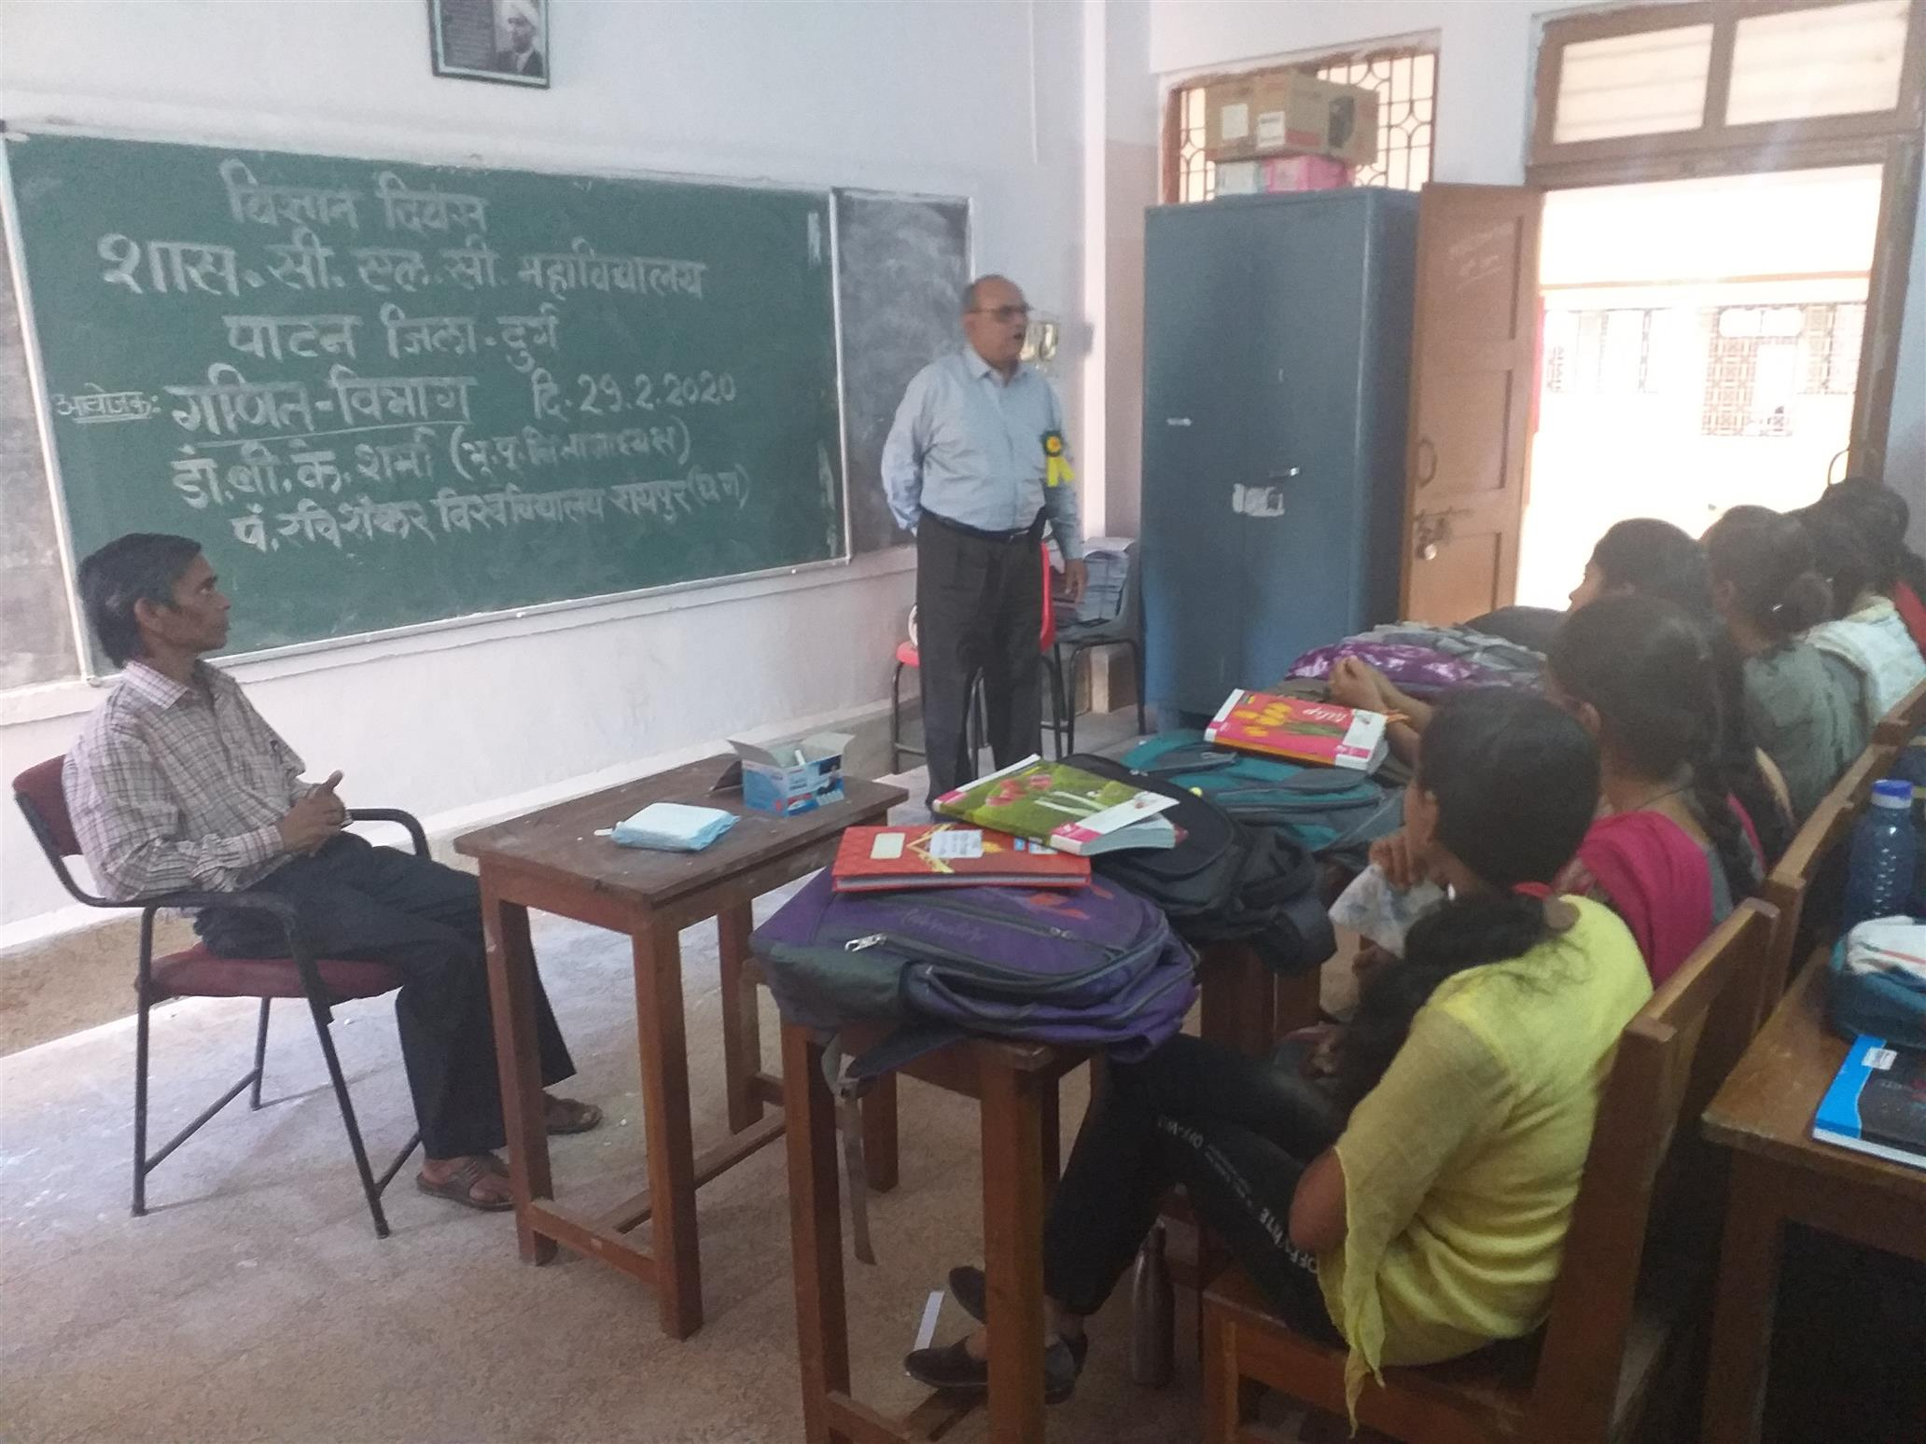
Guest Lecture Organized - NET Exam Awareness in Department
 | NET Exam awareness-2020 by Dr. B.K.Sharma (Ex-HoD, Maths, RSU) Raipur

Slide 36
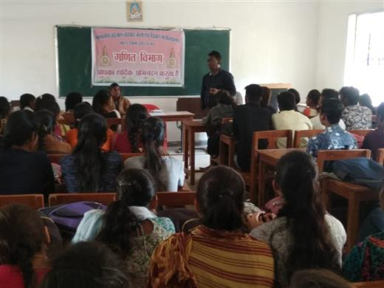
Guest Lecture by Satish Kaushik on 14.01.2019 | Black Board Presentation by Megha Verma on 07.11.2019

Slide 37
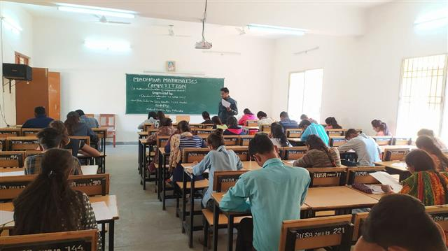
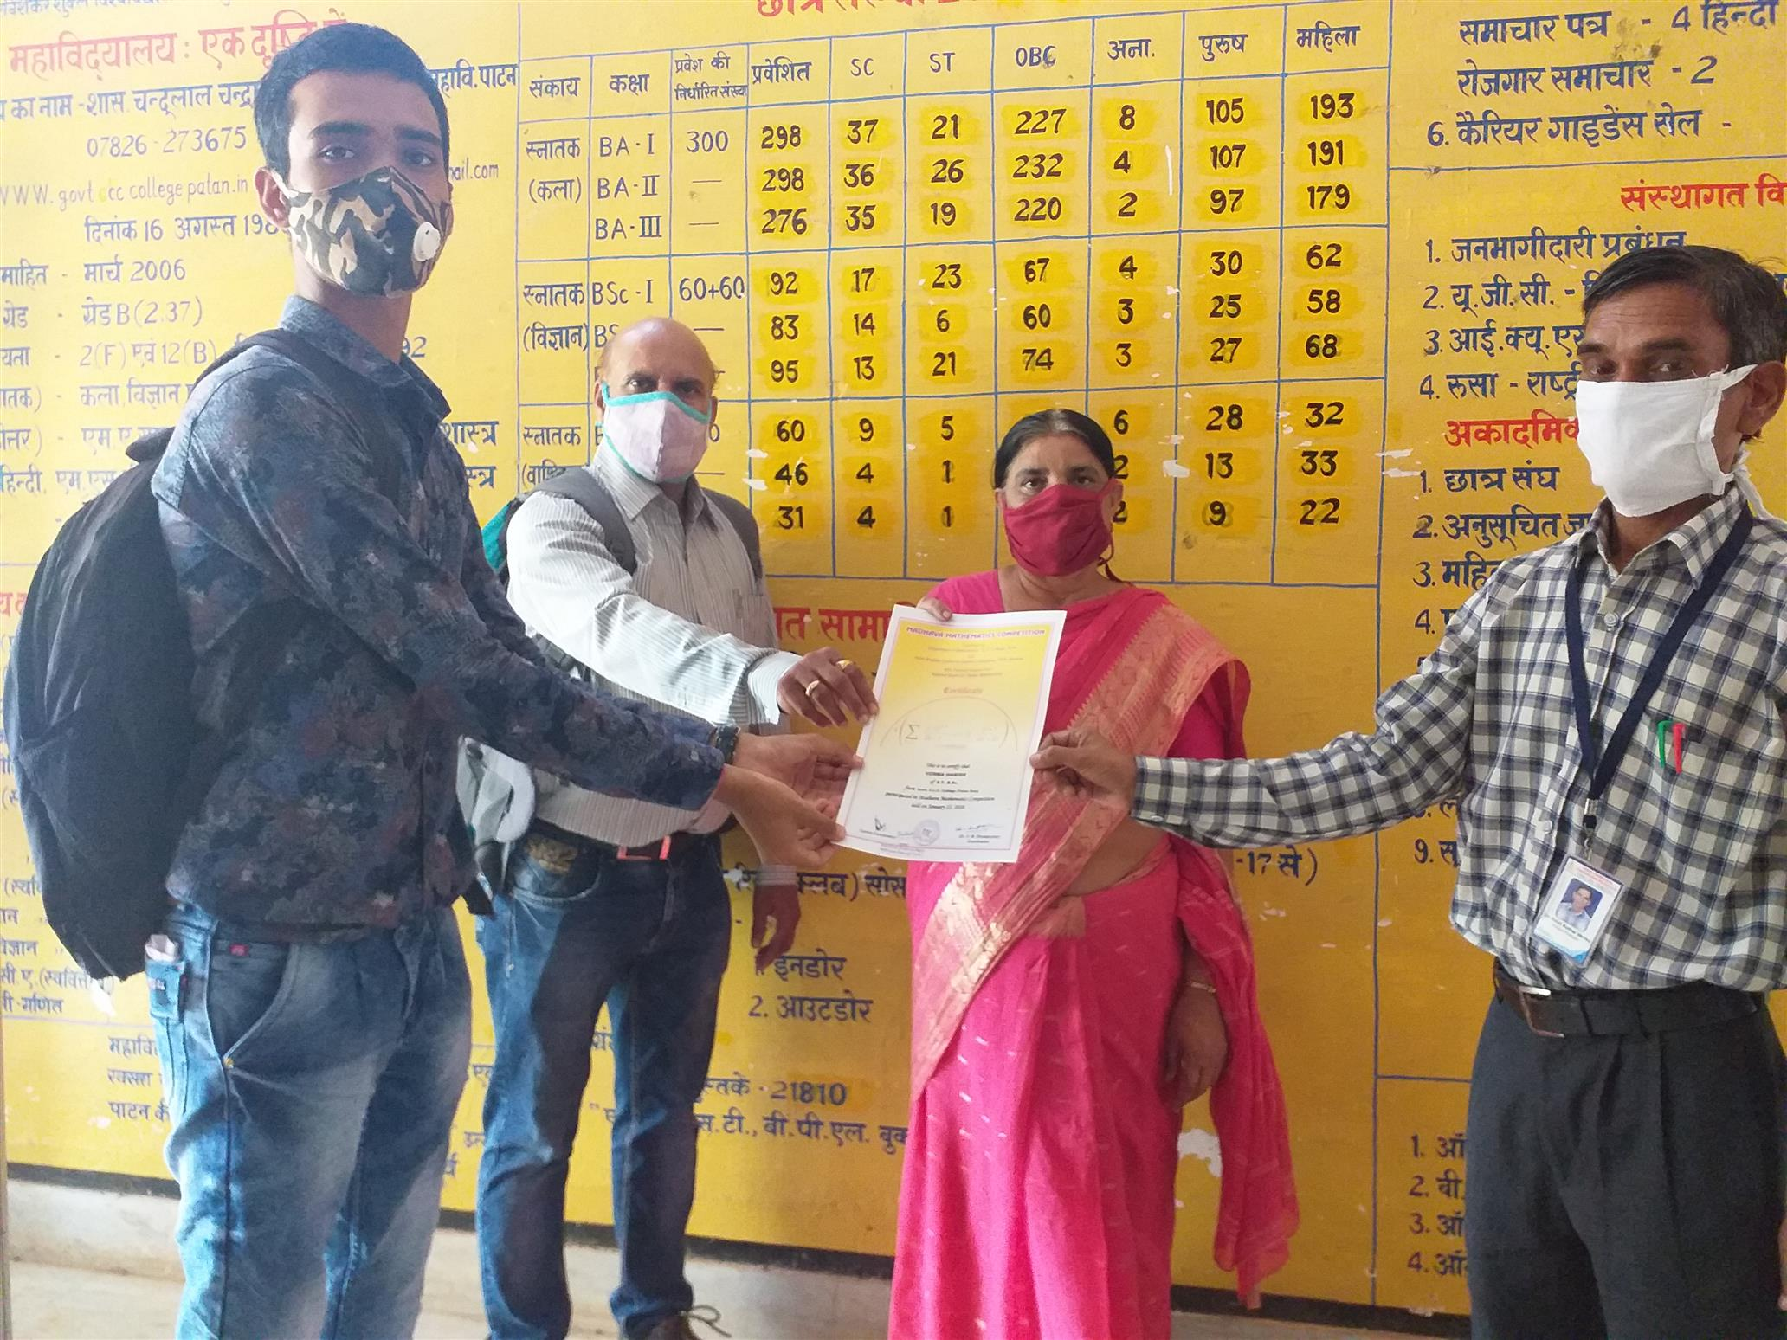
Memorable Achievements in Department of Mathematics
Madhav Mathematics National Level Exam-2020. Total 38 student Appeared | Distribution of Certificate of Madhav Mathematics Exam-2020 by Principal and HoD (Maths) and Sports Officer.

Slide 38
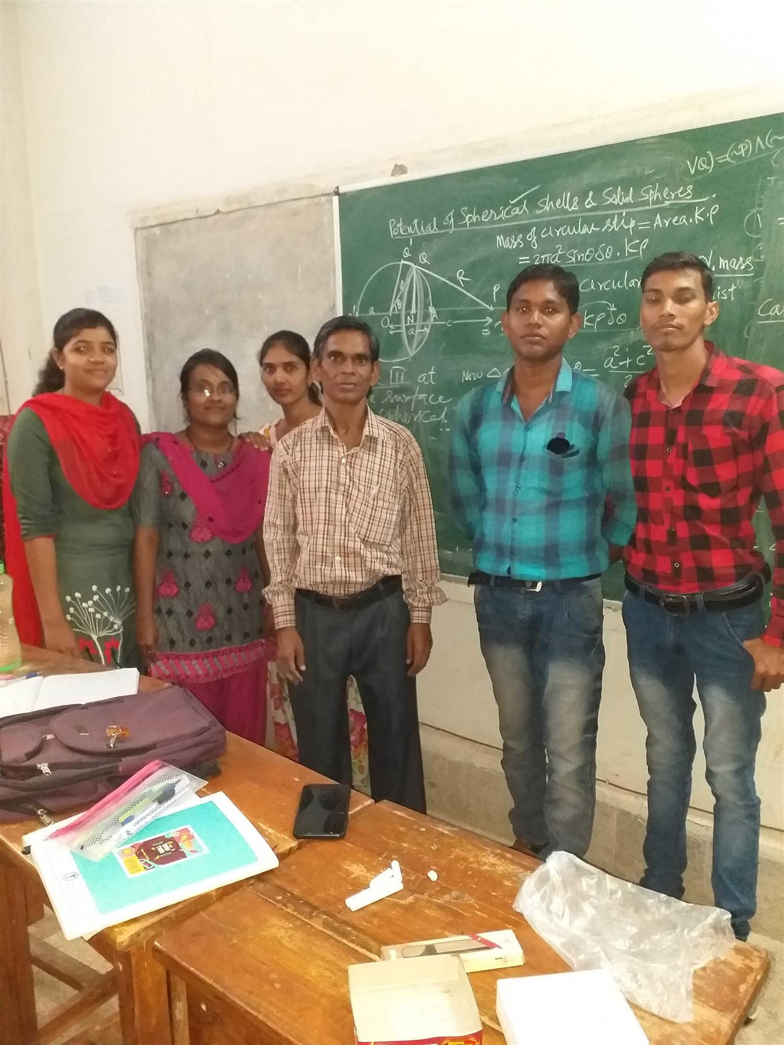
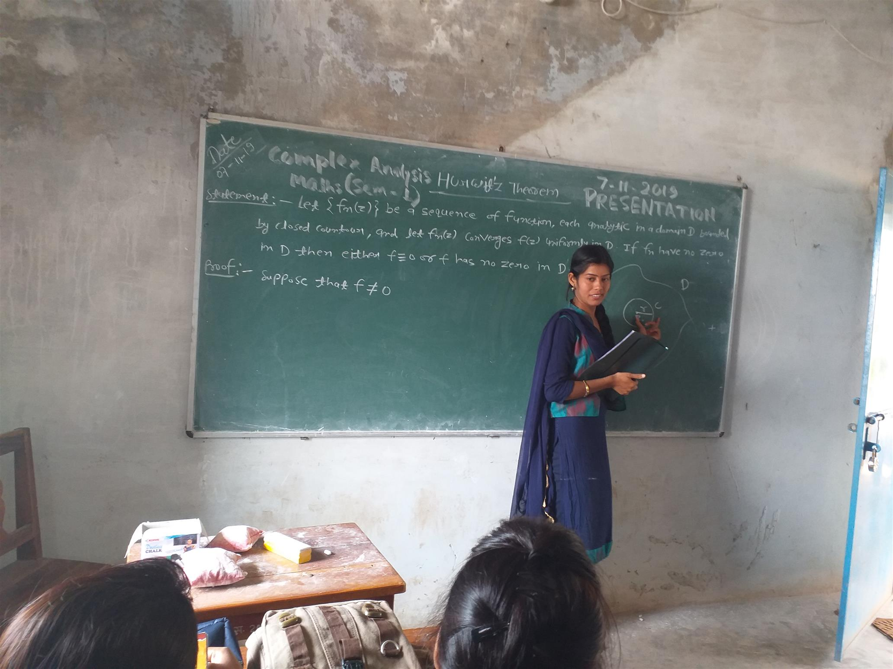
CLASSROOM ENVIRONMENT –(1) Black Board Presentation by Gitanjali in Semester-III Aug-2019 | A batch of M.Sc.-III semester attending the class-work of Attraction and Potential, Aug.-2019

Slide 39
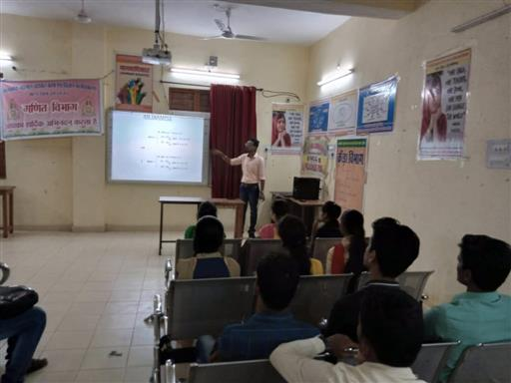
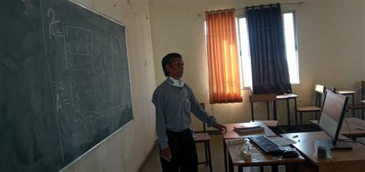
Use of ICT in Department and in Centralized online class

Slide 40
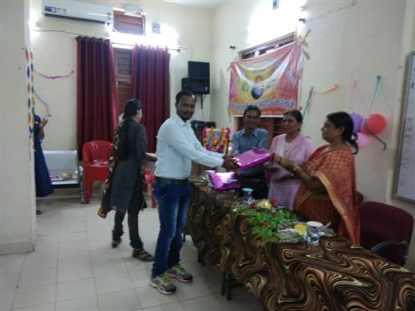
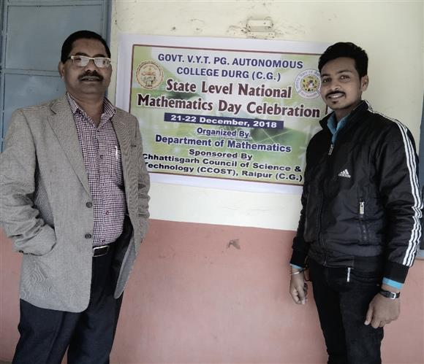
Memorable Achievements in Department of Mathematics
Teacher’s Day Celebration-Prashant Vishwakarma is Receiving Award from Principal Dr. Shobha Srivastava | Jay Shrivas is meeting with Experts of State Level Mathematics Day Celebration held on 21, 22, 23 Dec.-2018 at VYT Durg (C.G.)

Slide 41
Future Plan Vision 2030
Separate Well equipped Research Lab having Computer, Projector and Wi-Fi within proposed Science Block.
Produce at least 5 PhD scholars in next 10 years
Publish at least 20 research papers in international journals.
Establish as Research Center to the Mathematics Department
Try to creation of total 5 posts in the Department of Mathematics.
Launching Certificate course on Statistics of less than 6 months.
MoU with at least 5 Colleges to give and take expertise in Mathematics

Slide 42
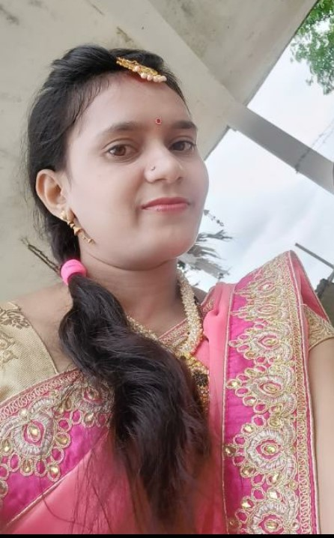
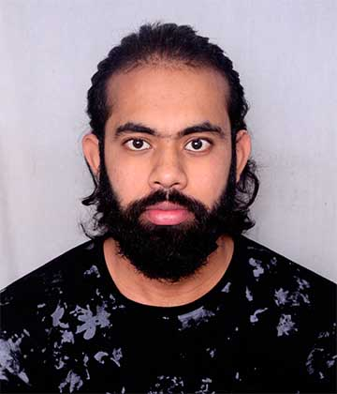
OUR RESEARCH SCHOLARS
KULESHWARI DESHMUKH | PRATIK SINGH THAKUR

Slide 43
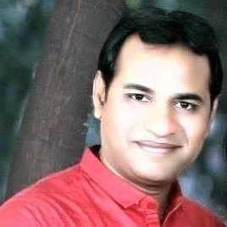
Our Alumni
Ms. Devi Vaishnav-Path Academy-Coaching Institute Patan | Ram Narayan Dewangan -Assistant Professor (Maths) in Govt. Engineering College Bilaspur

Slide 44
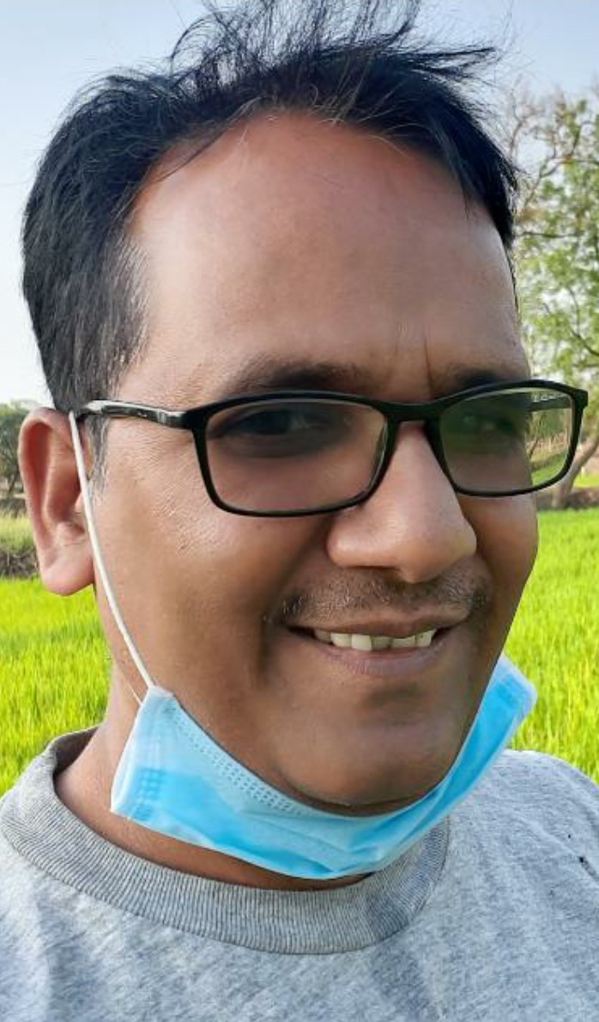
Our Alumni
Ms. PRIYANKA DEWANGAN, Assistant Dhal Singh Dewangan, Lab-Chemist Prof. (Physics) On contract basis at Govt. College Jamgaon (R)) | Dr. Mohan Lal Verma (Assistant Prof. Physics), SSCET Engineering College BHILAI

Slide 45
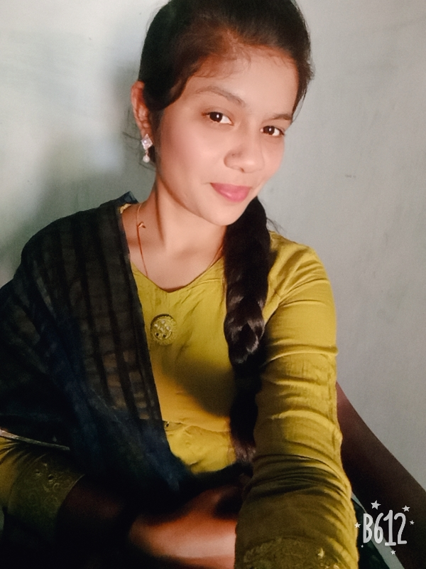
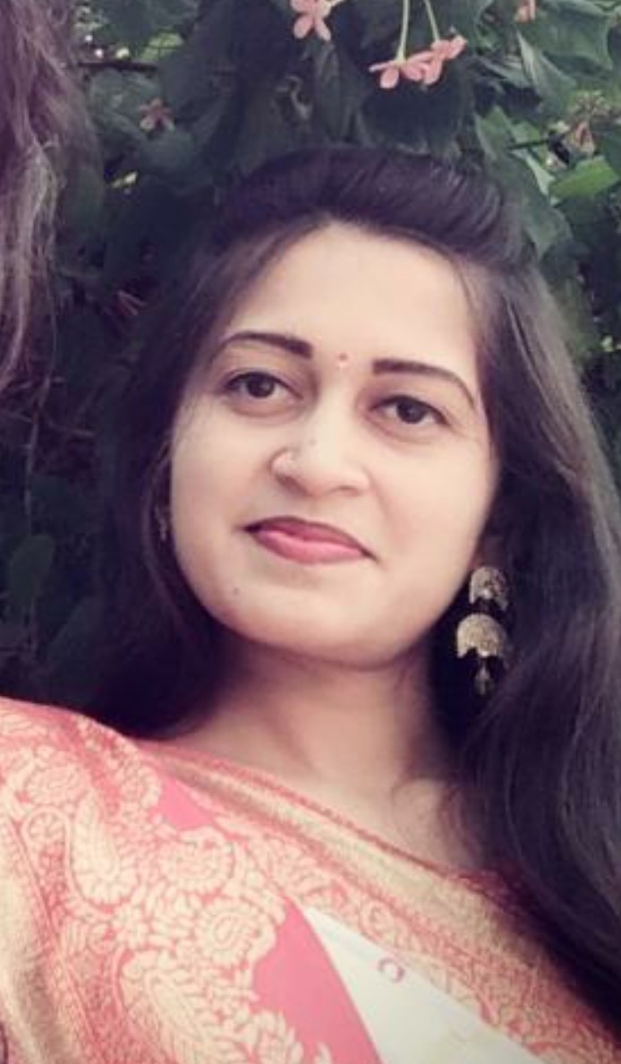
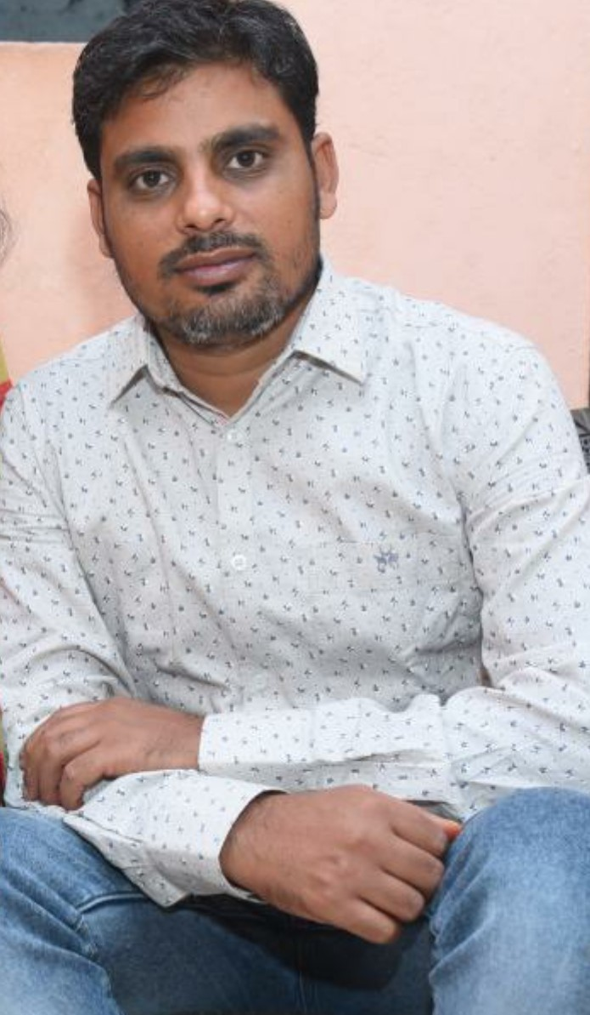
Our Alumni
Khileshwari Verma-India Post, Patan Branch | Damini Sahu-Asstt. Prof.-JBS (Jamgaon College, Physics) | Neeraj Soni, Member of JBS Committee, Govt. C.L.C. College Patan

Slide 46
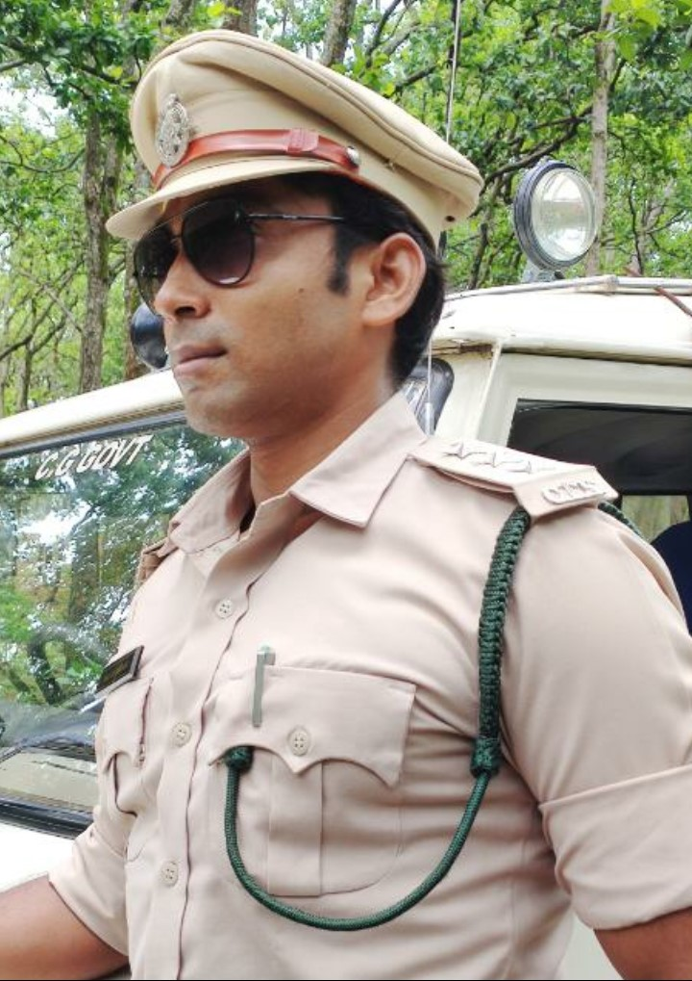
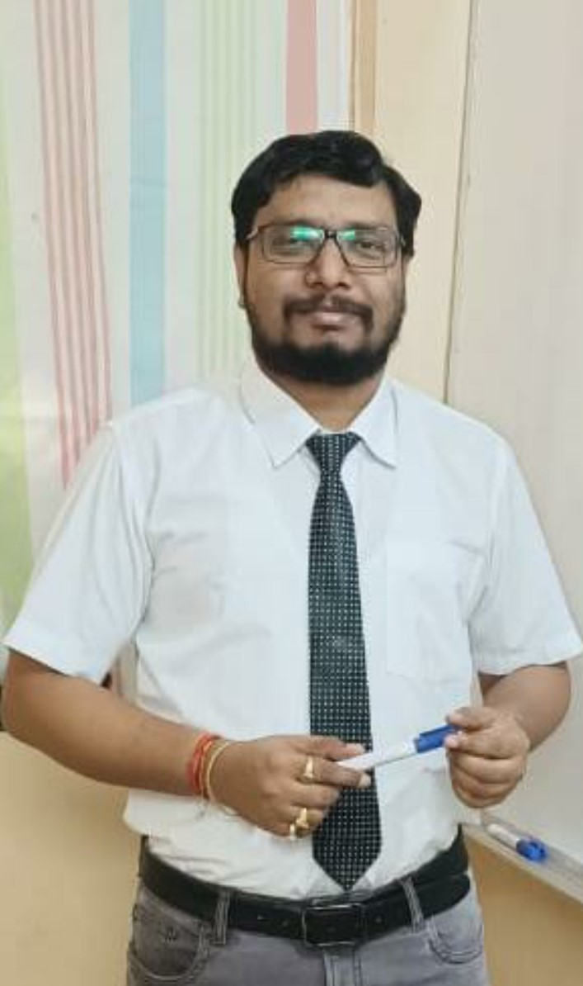
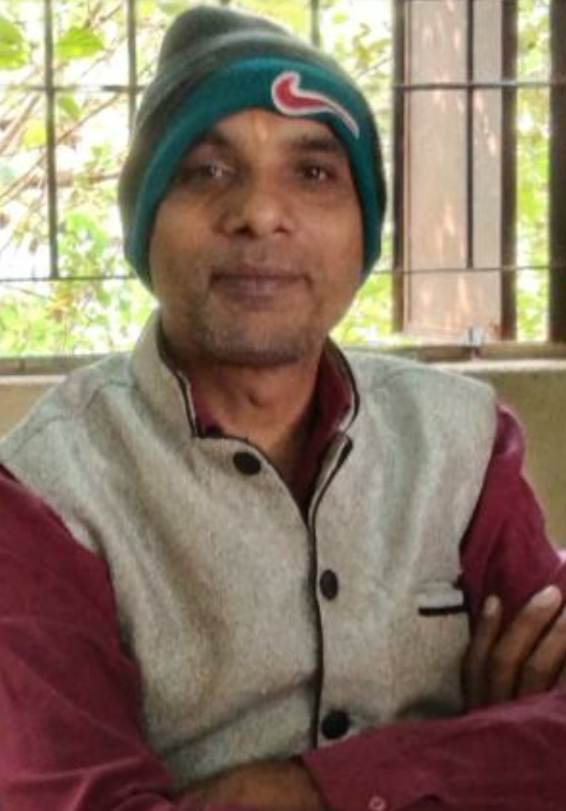
Our Alumni
Vikas Chandrakar, Chhattisgarh Forest Service | Yogesh Kaushik- Aakash Coaching Chemistry in Raipur Branch | Bharat Lal Verma- Lecturer in Mathematics, Govt. School Aheri

Slide 47
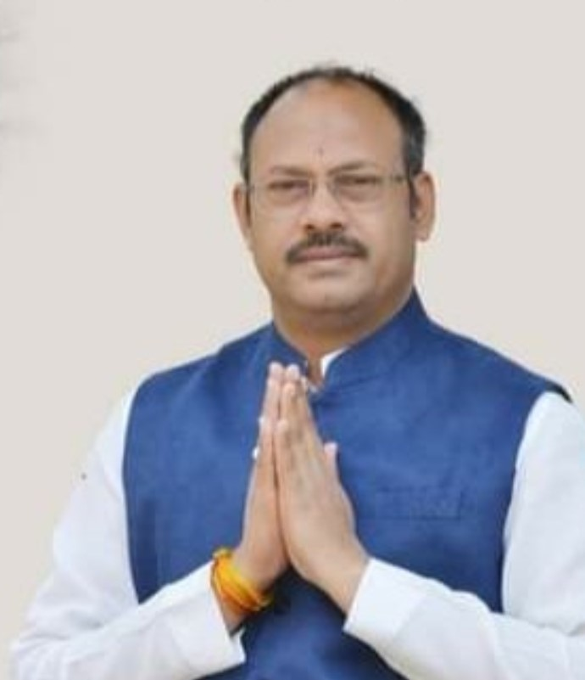
Our Alumni
Ashish
Ashish Verma, OSD for Chief Minister of Chhattisgarh | Mr. Jitendra Kumar Verma, Active in Politics and Social Service

Slide 48
/kU;okn

